Slide 1
Basic Facts and Computations
Building Fluency and Conceptual Understanding
Elementary Level
Copyright © 2019 American Institutes for Research. All rights reserved.
Notes:
[Handout.]

Slide 2
Developing an Understanding of the Data-Based Individualization Process
Handout #1

Slide 3
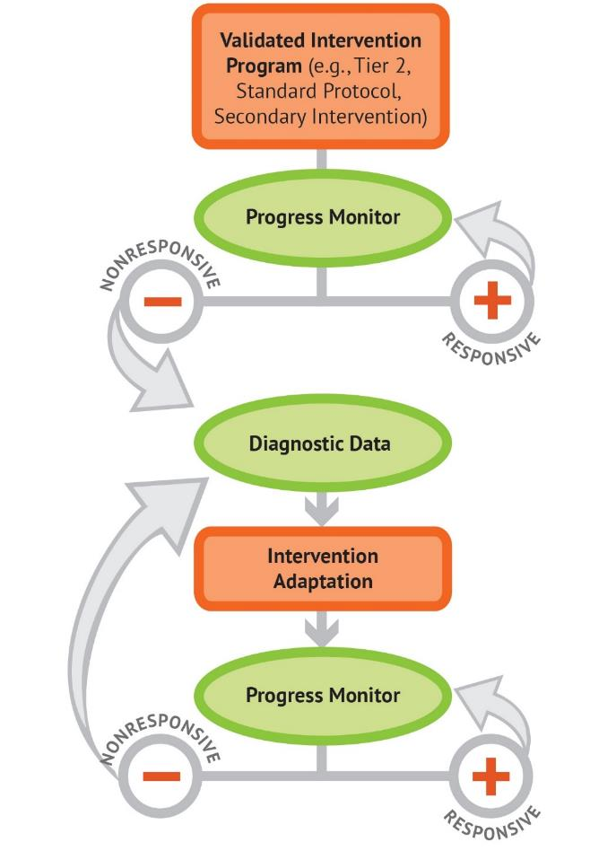
The Data-Based Individualization Process

Slide 4
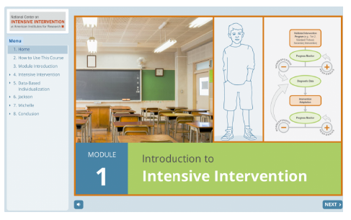
Introduction to Intensive Intervention
For additional information on the data-based individualization (DBI) process, check out the Introduction to Intensive Intervention module.
The self-paces module:
Defines intensive intervention and DBI;
Describes how intensive intervention fits within a tiered system such as MTSS (multi-tiered system of supports), RTI (response to intervention), or PBIS (positive behavior intervention and supports); and
Demonstrates how intensive intervention can provide a systematic process to deliver specialized instruction for students with disabilities.
https://intensiveintervention.org/resource/self-paced-introduction-intensive-intervention

Slide 5
Characteristics of Instruction Across the Tiers
 | Primary (T1) | Secondary (T2) | Intensive (T3)
Instruction/ Intervention Approach | Comprehensive research-based curriculum | Standardized, targeted small-group instruction | Individualized, based on student data
Group Size | Classwide (with some small-group instruction) | 3–7 students | No more than 3 students
Monitor Progress | Once per term | At least once per month | Weekly*
Population Served | All students | At-risk students | Students with significant and persistent learning needs
DBI is an approach to intensive intervention
*Or as indicated by the assessment instructions.

Slide 6
Five DBI Steps
Secondary intervention program, delivered with greater intensity
Progress monitoring
Informal diagnostic assessment
Adaptation
Continued progress monitoring, with adaptations occurring whenever necessary to ensure adequate progress

Slide 7
Mathematics Facts
Handout #2

Slide 8
What skills are we talking about?
Whole-number computation and mathematics fact fluency, defined by the National Council of Teachers of Mathematics (NCTM) (2002) as “having efficient and accurate methods for computing” (p. 152)
Connecting basic fact knowledge to multistep and multidigit computations

Slide 9
Why do students struggle with math facts?
Ineffective strategy use
Weaknesses in the following:
Retrieval or fluency
Procedures
Higher level or conceptual understanding
Arithmetic relations among numbers
Working memory can affect a child’s ability to apply strategies to effectively solve whole-number computations and word problems.
Sources: Geary, 1993, 2005; Gray, Pinto, Pitta, & Tall, 1999; Impecoven-Lind & Foegen, 2010; Jayanthi, Gersten, & Baker, 2008; Hecht, Close, & Santisi, 2003; Raghubar, Barnes, & Hecht, 2009; Swanson & Jerman, 2006; Swanson, Jerman, & Zheng, 2008
Notes:
Students struggle with math facts because they often use inefficient strategies to solve, thus never fully mastering or memorizing the facts. For many students, the inefficient strategies include counting all. For example, 5 + 3 would include counting five fingers and then counting on three more. A more efficient strategy would be to simply say 5 and then count on three more, so 5, 6, 7, 8 versus 1, 2, 3, 4, 5, 6, 7, 8. Additionally, students who struggle lack the understanding of how numbers are related—knowing that 5 + 3 is 8 and 8 – 3 = 5—thus the idea of part-part-whole and how addition is related to subtraction.

Slide 10
What is expected of students?
Third-grade students demonstrate mastery, defined as 80% or better in accuracy
Addition and subtraction facts
Products of two 1-digit numbers
Beyond basic fact mastery, students need to be able to extend fact knowledge to application of multistep problems involving different operations.
Sources: National Governors Association Center for Best Practices & Council of Chief State School Officers: Common Core State Standards for Mathematics & NCTM, 2014; National Mathematics Advisory Panel, 2008
Notes:
Ideally, students need to have mastery of basic facts (addition, subtraction, multiplication, and division) in order to be successful in multistep computations, fractions, and decimals. Teachers need to explicitly teach strategies that lead to mastery across the four skills. Ideally, by Grade 5,students will score 80% or better when given 1-minute assessments in addition, subtraction, multiplication, and division.

Slide 11
Vocabulary List
Brainstorm a list of words you use when teaching facts and computation.
READY
SET
GO!
Handout #3
Notes:
[Give 1 minute for each table to brainstorm a list of words that would be part of facts and computations. After 1 minute, have participants state the words round-robin style. The purpose is to show how much vocabulary is part of fact instruction that may or may not be explicitly taught.]

Slide 12
Activity #1
Handout #4
Student-friendly definition:
Picture or symbol:
Example:
Example:
Nonexample:
Notes:
[Have participants select a word that was part of the brainstormed list and then share with their small groups or the larger group.]

Slide 13
Fact Strategies and Progression
Handout #5
Notes:
In order for students to be successful in basic facts, teachers should introduce and teach in a systematic progression that builds upon skills. When facts are introduced through learning progressions, mastery is often easier to attain.

Slide 14
Fact Progression: Addition and Subtraction
Fact Strand | Strategy
Part-part-whole: foundational skills | Break apart whole number, no mathematical symbols.
+/− 0 | 0 rule: “Any number plus or minus a zero always equals that number.”
+/− 1, 2, 3, 4 | Count on and count back.
Doubles and related | Count by 2s.
Doubles +1 and related | Identify the number that is less, double this number, and then add 1 more.
Make 10 and related | Using 10-frames to build mastery and memorization of facts that total 10.
Ten plus more and related | Using place value to show a group of 10 and more.
Make 10 plus more and related | Identify the greater number and make 10 from the lesser valued number.
Notes:
Addition and subtraction should be taught together so that students develop the understanding that part-part-whole is related. Ideally, students have mastered a fact strand prior to the next fact strand being introduced. The first fact strand is less a strand than developing understanding of numbers. During this time, the students are decomposing numbers and understanding that the equals sign means “the same as” rather than the answer. Examples at this level are writing the multiple ways to write numbers and partner equations (e.g., 7 + 1 = 4 + 4; 8 = 2 + 6, 3 + 5 = 8).
After this first fact strand, instruction changes to more facts and equations beginning with “plus and minus 0,” then moving to “plus and minus 1, 2, 3, 4” and using the count-on and count-back strategy, then doubles using the strategy of skip-counting by twos. Using their knowledge of number sense and doubles, doubles plus one is introduced next. These are facts that include “neighbors on the number line,” such as 8 + 9 or 7 + 6. The student identifies the number that is less than, doubles it, and adds on one more. Following this fact strand is “make 10” and related. These are the fact combinations that equal 10 (1 + 9, 2 + 8, 3 + 7, 4 + 6). After make 10 and related, then it is 10 plus more introducing the idea of teen numbers. Both of these skills help to solve the more challenging facts of make 10 plus more. In this last fact, the students identify the greater number (e.g., 9 + 5; 9 becomes 10 by taking one away from 5, so 10 + 4 = 14 and 9 + 5 = 14).
[For additional support in fact strands, see the Early Numeracy Intervention module.]

Slide 15
Fact Progression: Multiplication and Division
Fact Strand | Strategy | Example
×/÷ 0, 1 | Generalization or rule | Any number multiplied by 0 equals 0. Any number multiplied by 1 equals that number.
×/÷ 2, 5, 10 | Skip-count | 2 × 6 = 2, 4, 6, 8, 10, 12
×/÷ 9 | Make 10 minus the factor | 9 × 7 = (10 – 1) × 7 (10 × 7) – (1 × 7) 70 ­– 7 = 63
×/÷ 4/8 | Double it two times/double it three times | 4 × 7 = (2 × 2) × 7 2 × 2 × 7 = 2 × 14 2 × 14 = 28
Notes:
Similar to addition and subtraction, multiplication and division should be explicitly taught. Many teachers and students rely on repeated addition to solve multiplication, but this is often inefficient and time consuming. Additionally, if students lack mastery and fluency of addition facts, this will often lead to errors in solving and lack of fluency. When students have strong number sense and understand that decomposing numbers does not change the whole, these strategies will be easier to instruct, learn, and apply. [Have participants spend time applying each strategy.]

Slide 16
Fact Progression: Multiplication and Division
Fact Strand | Strategy | Example
×/÷ 6 | Break apart 6 and then put back together or double it three times | 6 × 8 = (1 + 5) × 8 (1 × 8) + (5 × 8) = 8 + 40 = 48
×/÷ 7 | Break apart 7 and then put back together | 7 × 6 = (5 + 2) × 6 (5 × 6) + (2 × 6) = 30 + 12 = 42
×/÷ 3 | Break apart 3 and then put back together or count by | 3 × 8 = (2 + 1) × 8 (2 × 8) + (1 × 8) = 8 + 16= 24
Notes:
[Have participants spend time applying each strategy. After reviewing each strategy, have a discussion about fact strategies.] What are the prerequisite skills needed to apply these fact strategies? How can they be presented? Each table will be assigned one of these facts to illustrate. They will show how to teach the fact strategy. Are there any other ways to solve?

Slide 17
Teaching Multidigit Computation
From Basic Facts to Multistep
Handout #6
Notes:
[The handout includes strategies, but not standards, slides 29 and 30.] Just as word problems are an instructional method to test math skills, multidigit computation is the application of facts. At-risk students struggle with working memory, and this affects their ability to solve multidigit computations. “Multidigit computations” refers to addition, subtraction with and without regrouping, multidigit multiplication, and long division.

Slide 18
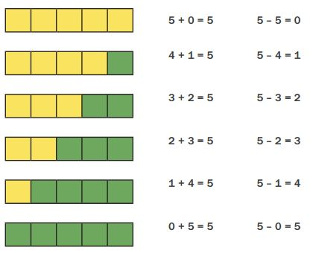
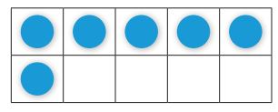
Instructional Progression: Evidence-Based Practices
Multiple representations
When a new strategy is introduced, it is best to start with the concrete representation(s)
Link concrete to part-part-whole mat, number lines, groups
Move to a symbolic or pictorial representation
Including number lines, 10-frames, pictures of the manipulatives
Abstract or equations alone
Notes:
The purpose of the representations is to show why the strategy works versus simply teaching a trick. For some students, seeing the concrete one time is enough, and they may move to pictorial quickly. For other students, concrete can be easier to work with or count, and they may need it much longer. Using the data and observations of how the students use each representation can aid in scaffolding back or providing less support via representations.

Slide 19
Scaffolding Within DBI
The scaffold, as it is known in building construction, has the following five characteristics:
It provides a support.
It functions as a tool.
It extends the range of the worker.
It enables a worker to accomplish a task not otherwise possible.
It is used selectively to aid the worker where necessary (Greenfield, 1999, p. 118).
Types of instructional scaffolds:
Teacher or peer
Content and task
Materials
Notes:
In the past, scaffolding was directed by the adult—the teacher or the tutor. Many more classrooms are becoming project or inquiry based, meaning that children are in charge of their learning, with the teacher acting as the facilitator. With this change, the way we think about scaffolds also changes. Now, the scaffold can be provided by the teacher, but also by a peer, in the actual skills, progression, or timing of the content, as well as changing the task. We will discuss ways to scaffold over the next few slides. It is important to think about the use of scaffolds paired with explicit instruction as a way to meet individual needs as part of the DBI process.

Slide 20
Teacher and Peer Scaffolds
Address prerequisite skills
Preview new skills
Types of questions or clarification questions
Including follow-up questions
Teach students to ask questions and explain thinking
Moves conversations away from only teacher–student to student–student
Reduce the “step size” from one idea or representation to the next
Teach the use of cognitive strategies
Notes:
It is important to remember that when we think of instructional scaffolds paired with explicit instruction, the teacher is providing support for the student to gain mastery of a specific skill. The purpose of gaining mastery with support is to build the student’s independence level; thus, when the support has faded, the student is able to perform the skills/tasks independently. Much like multiple representations, a student might need additional scaffolds one day and something different the next day. Or the student might be able to work without any additional scaffolds but will need the scaffolds when another step or a new skill is introduced. Again, this flexibility in the types of scaffolds used is similar to how multiple representations should be weaved and connected throughout skill building to mastery.

Slide 21
Content and Task Scaffolds
Build sequence of skills to introduce easier concepts first
Increase difficulty based on data
Use of high probability to develop worksheets
Sequence instruction so teacher models and then decreases role as lesson continues
Guide students to work with one another; reciprocal teaching
Notes:
[Read slide.]

Slide 22
Material Scaffolds
Types and sequences of manipulatives
Counters
Number lines
10-frames
Part-part-whole mats
Base 10 materials
Use of games and puzzles
Linking instruction to word walls
Use of technology
Notes:
[Read slide.]

Slide 23
Strategies: Addition and Subtraction
Connect to basic facts
Systematic practice
Create multidigit problems containing facts already mastered
Focus on the conceptual understanding rather than facts
Link operations through fact family
Use multiple representations to develop the understanding of how addition and subtraction are connected
Practice addition and subtraction together, as a means to check work, as well as to develop mastery
Notes:
[Read slide.] Linking operations from the beginning and through each fact strand is essential. This also supports students’ number sense and can lead to deeper conceptual understanding and application to facts as well as advanced computations and reasonableness of answers.

Slide 24
Strategies: Addition and Subtraction
Isolate the place-value columns.
28 2 tens 8 ones
+14 + 1 ten 4 ones
42 3 tens 12 ones = 4 tens, 2 ones
Connect to powers of 10 to help identify patterns within place value.
2 20 200
+3 +30 +300
5 50 500
Mix problems that require regrouping with those that do not.
Notes:
These are examples of how linking place value to facts within multidigit computations can lead to conceptual understanding and procedural fluency.

Slide 25
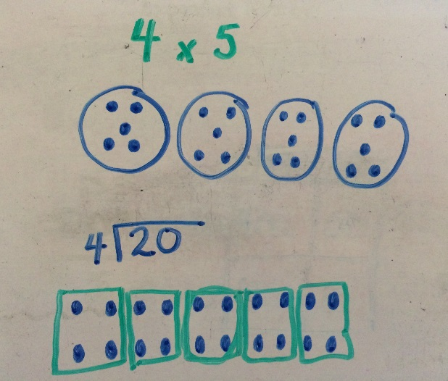
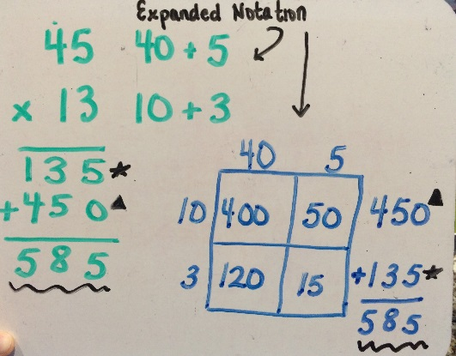
Strategies: Multiplication and Division
Connect to basic facts
Systematic practice
Create multidigit problems containing facts already mastered
Focus on the conceptual understanding rather than facts
Link operations through fact family
For division, think multiplication
Show how the operations are related
Show and explain the traditional algorithm
Notes:
[Read slide, emphasizing that it is important to teach conceptual understanding rather than simply teaching the traditional algorithm.]

Slide 26
Case Examples: Error Analysis
Identifying Error Patterns to Help Individualize Instruction

Slide 27
Case Examples
Each slide contains a sample of a student progress monitoring measure.
Includes either facts or computation
Complete the table for each student.
Identify the type of error
Fact error
Conceptual or misconception
What evidence do you have to justify the type of error?
What instructional adaptations are necessary?
Handout #7
Notes:
[Have participants complete each case study, or assign a different case study to groups of students and then have groups share their findings. Each handout contains the sample work. Participants will complete the type of error, the evidence for how they know whether it is a fact or strategy error, and possible instructional adaptions.]

Slide 28
Case Example 1
Sample Work | Type of Error | What Evidence? | Instructional Adaptation(s)
7 = 6 + 2 3 + 5 = 8 5 6 +5 +7 10 15
Notes:
This will be completed together. Empty tables are in the workbook.

Slide 29
Case Example 2

Slide 30
Case Example 2
Type of Error | What Evidence? | Instructional Adaptation(s)
Notes:
Each table will be assigned a case example. The answers will not be reviewed until the end. Participants will have empty tables

Slide 31
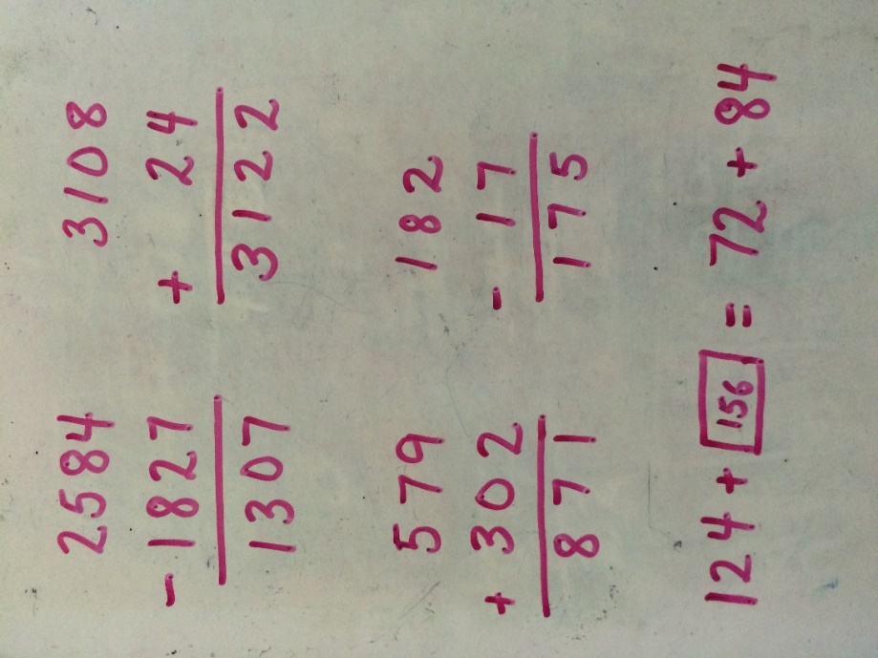
Case Example 3

Slide 32
Case Example 3
Type of Error | What Evidence? | Instructional Adaptation(s)

Slide 33
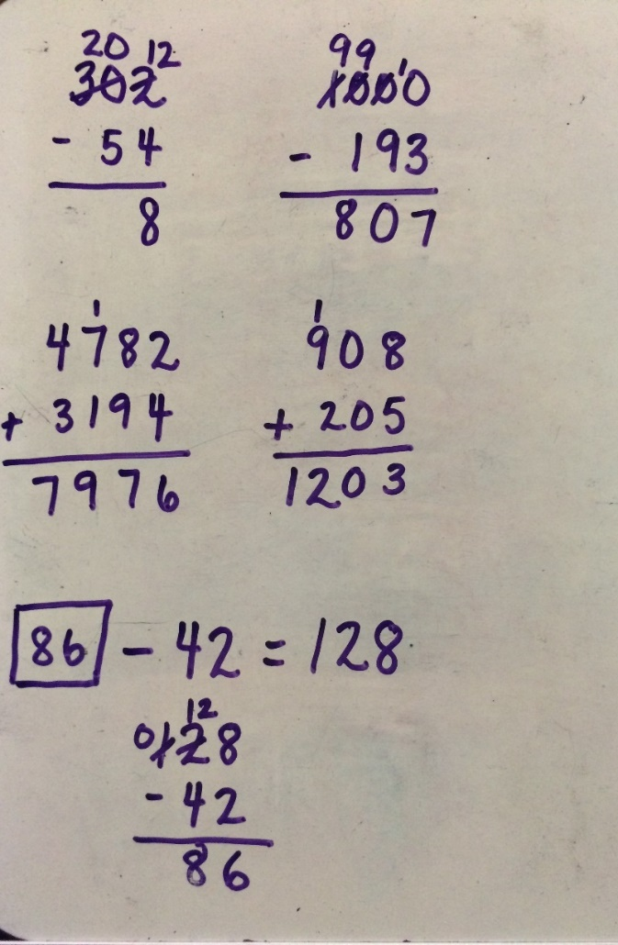
Case Example 4

Slide 34
Case Example 4
Type of Error | What Evidence? | Instructional Adaptation(s)

Slide 35
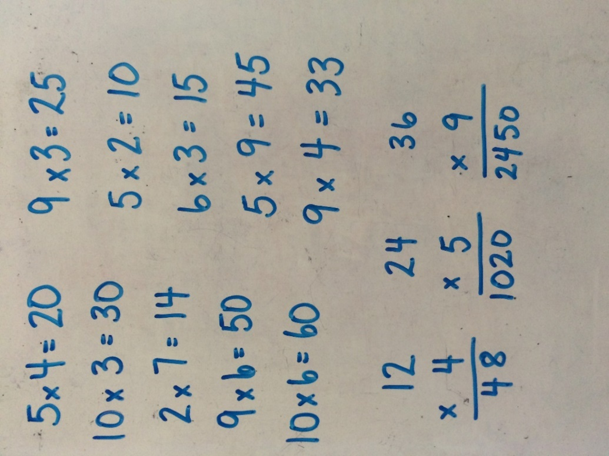
Case Example 5

Slide 36
Case Example 5
Type of Error | What Evidence? | Instructional Adaptation(s)

Slide 37
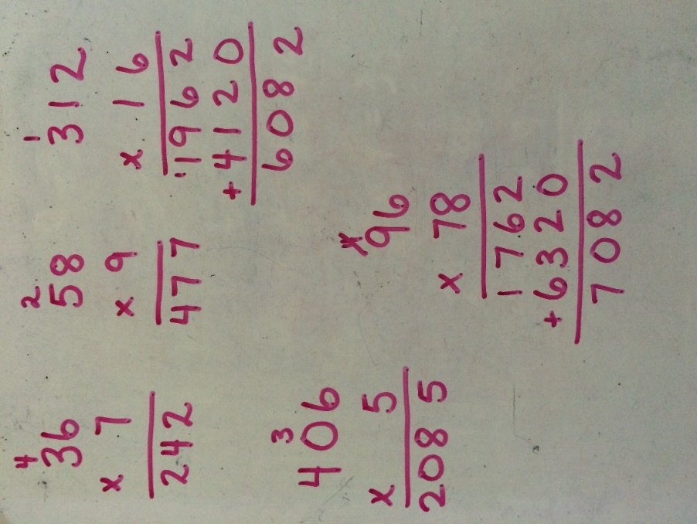
Case Example 6

Slide 38
Case Example 6
Type of Error | What Evidence? | Instructional Adaptation(s)

Slide 39
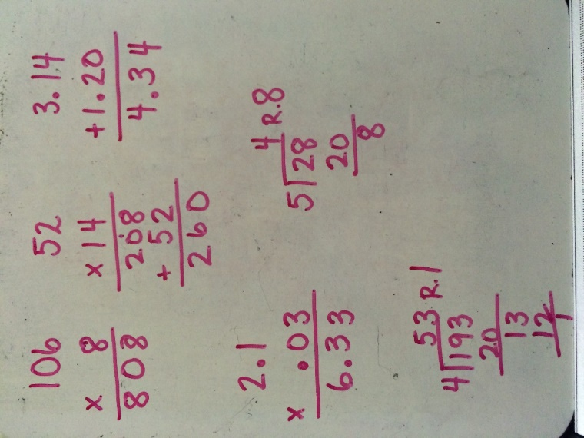
Case Example 7

Slide 40
Case Example 7
Type of Error | What Evidence? | Instructional Adaptation(s)

Slide 41
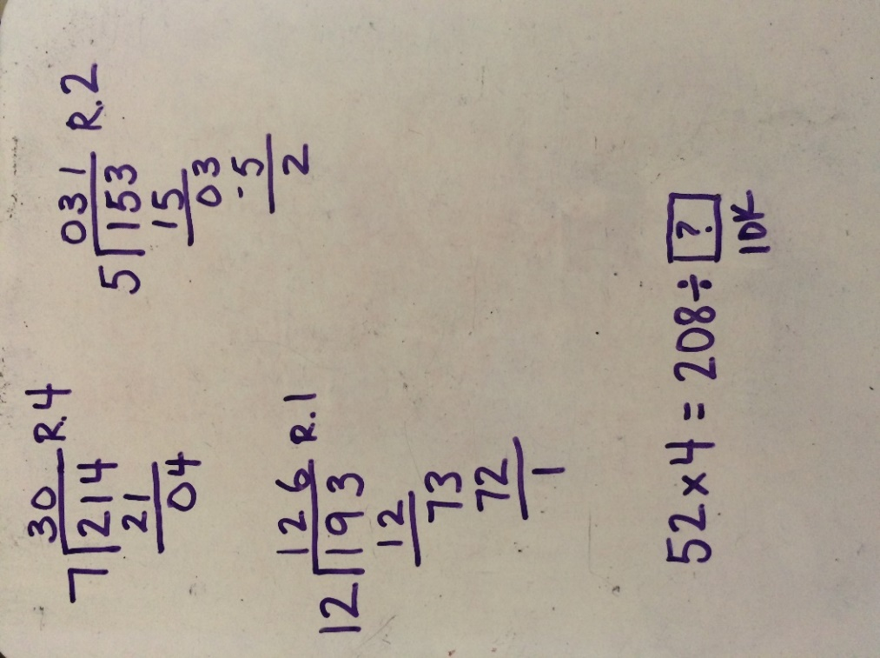
Case Example 8

Slide 42
Case Example 8
Type of Error | What Evidence? | Instructional Adaptation(s)

Slide 43
Conclusion
Handout #8

Slide 44
Summary
Explicit, basic fact instruction is vital! For students who struggle, teachers must be systematic in how they deliver fact instruction.
Students need mastery of facts, starting with addition and subtraction, to be successful in multidigit computations, thus freeing their working memory.
Teachers should use multiple representations to show how to solve facts and build conceptual understanding while leading to procedural fluency.

Slide 45
Disclaimer
This module was produced under a grant from the Investing in Innovation Fund (i3), U.S. Department of Education, Award No. U411C140029.
The views expressed herein do not necessarily represent the positions or polices of the U.S. Department of Education. No official endorsement by the U.S. Department of Education of any product, commodity, service, or enterprise mentioned in this website is intended or should be inferred.

Slide 46
Info
1000 Thomas Jefferson Street NW
Washington, DC 20007-3835
General Information: 202-403-5000
www.air.org

